Slide 1
Visual Modeling
&
Unified Modeling Language
(UML)
Satish Mishra
mishra@informatik.hu-berlin.de

Slide 2
This session
Visual modeling
  What is visual modeling
  Benefits of visual modeling
UML
  History of UML
  Goal
  Classification
UML Resource
  Links

Slide 3
Definition of Visual Modeling
Mapping real-world process of a computer
system with a graphical representation
Visual Modeling is a way of thinking about problems by using graphical models of real-world ideas.

Slide 4




What is Visual Modeling ?
Order
“Modeling captures essential
parts of the system.”
Dr. James Rumbaugh
Item
Ship via
Business Process
Visual Modeling is modeling
using standard graphical notations
Computer System
Notes:
3
Core Message: Modeling captures essential parts of the system
Key Point 1: Computer system basically automate business processes. However, it’s not easy to build software systems on time and within budget.
Key Point 2: Building a complex software system requires blueprint. You don’t construct a building without a blueprint. Visual modeling is the blueprint for software systems.
Conclusion: VM is a key to successful software development

Slide 5
Benefits of visual modeling
Captures Business Process
Enhance Communication
Manage Complexity
Define Architecture
Enable Reuse

Slide 6
Capture Business Processes
When we create use cases, visual modeling allows us to capture business processes by defining the software system requirements from the user's perspective.

Slide 7
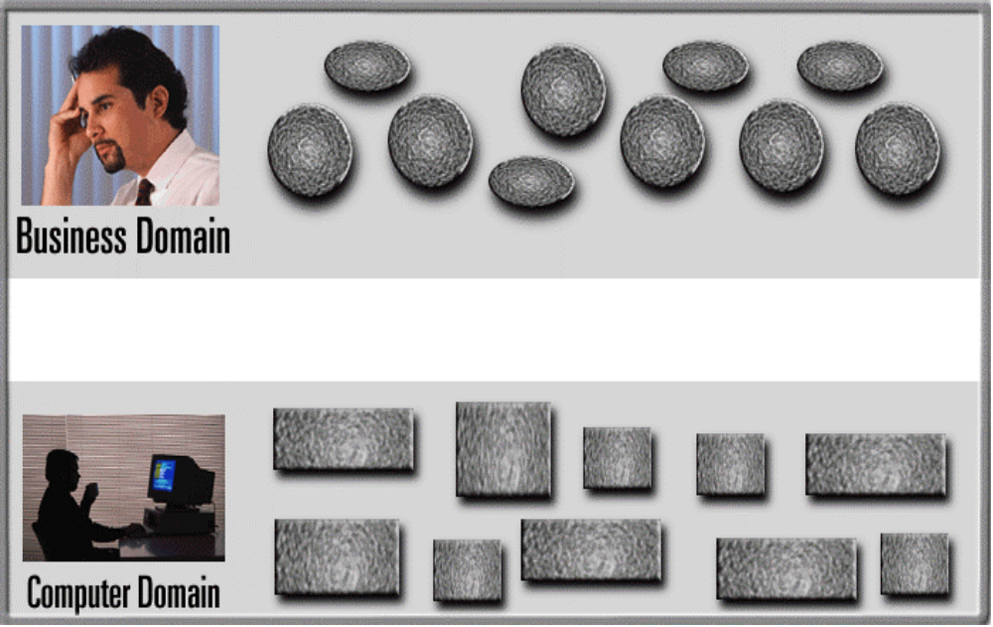
Visual Modeling is a Communication Tool
Use visual modeling to capture business objects and logic
Use visual modeling to analyze and design your application
Notes:
5
Core Message: VM is a communication tool.
Key Point 1: Business analyst and domain experts define requirements. Software architects and developers build systems based on requirements. Typically, they have communication problems due to different use of terminology and different definition of concepts.
Key Point 2: Take a look at the Rose development team. The team is distributed in three cities around the world; Sweden, Milwaukee, and Philadelphia. There is a common language - visual modeling.
Key Point 3: With VM, there is a smooth transition between business domain and computer domain. Also, you can establish traceability from business domain to computer domain.
Conclusion: VM is a communication tool.

Slide 8
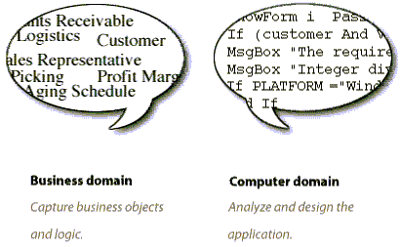
Enhances Communications
These teams must work together closely, but too often communication is strained by misunderstan-dings arising from differences in terminology.
Visual modeling has one communication standard, the UML, providing a smooth transition between the business domain and computer domain.
Business analysts and domain experts define system requirements
Software architects and developers build the system based on these requirements

Slide 9
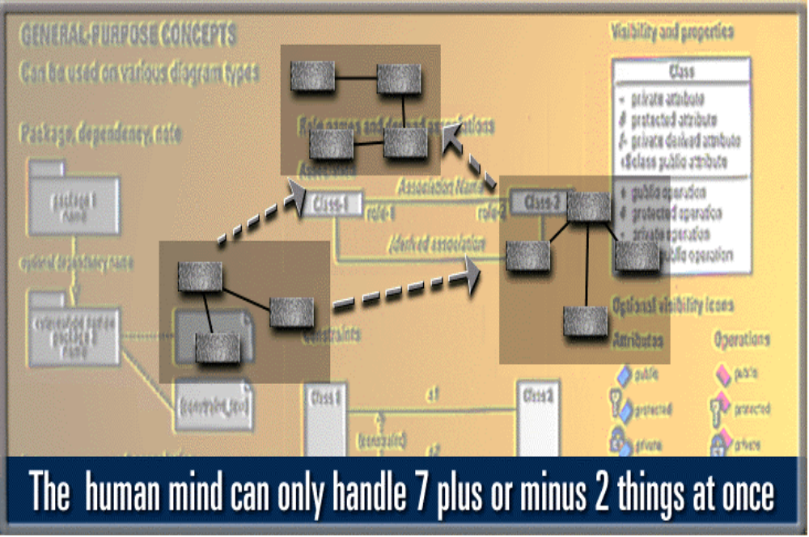
Visual Modeling Manages Complexity
Systems today typically have hundreds or even thousands of classes.
These classes must be organized in such a way as to allow viewing by many different groups of people; often with each group having their own viewing needs.
Visual modeling provides the capability to display modeling elements in many ways, so that they can be viewed at different levels of abstraction.
Notes:
6
Core Message: VM manages complexity
Key Point 1: This is a model of typical system. Sale has information about purchase order, sales person, and customer. In a system, you may get hundreds or thousands of these things (or objects).
Key Point 2: Human mind can only handle 7 plus or minus things at once. VM allows you to raise your level of abstraction. There are constructs to group things into more manageable number of things.
Example: One new developer joins the group. How do you describe your software system?
Conclusion: VM manages complexity

Slide 10
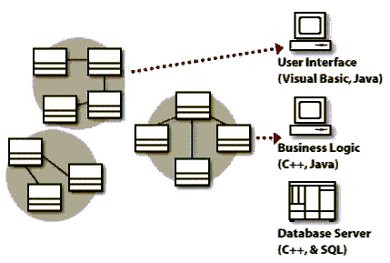
Visual Modeling Defines Software Architecture
Visual modeling provides the capability to capture the logical software architecture independent of the implementation language.
As system design progresses, the implementation language is determined and the logical architecture is mapped to the physical architecture.
Notes:
7
Core Message: VM defines software architecture
Key Point 1:Model of a system is essentially a software architecture. You can then map it to the physical architecture. For example, this is a three tier architecture - mapping logical to physical.
Key Point 2: Model your system independent of the implementation language. Technology change too much too fast. A few years ago, C++ was the language of the future but today it’s Java. How do you plan to change your system from PowerBuilder to Visual Basic? Reuse models.
Conclusion: VM defines software architecture

Slide 11
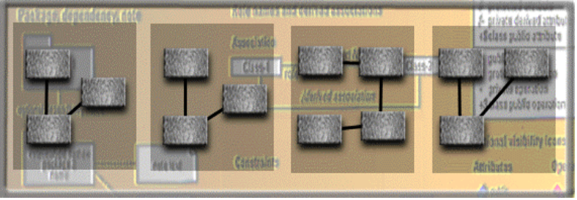
Visual Modeling Promotes Reuse
Multiple Systems
With Visual Modeling we can reuse parts of a system or an application by creating components of our design.
Reusable
Components
Notes:
8
Core Message: VM promotes reuse.
Key Point 1:On previous slide, we talked about reusing a model.
Key Point 2:There is a higher leverage of reuse. Reusing parts of the system or an application. For example, a component is an application in a binary format, whether the component is made of objects or not. VM can be used as a component browser and it can also be used to model component assembly.
Conclusion: VM promotes reuse.

Slide 12
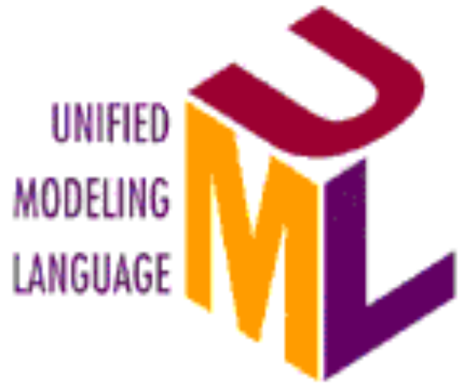
How can you realize the benefits of visual modeling?
By using the Unified Modeling Language.
The UML is a standard language for visualizing, specifying, constructing and documenting the artifacts of a software system.

Slide 13
Design methods evolution
1997
OOAD with UML
1990
OOAD
1986
CASE
1986
OOP
1980
4GL
1980
Data Modeling
1980
Structured Analysis
1975
Structured Design
1970
Structured Programming

Slide 14
In The Beginning, There Was OMT, Objectory, and The Booch Method
Three very different kinds of OO methods.
Each method had strengths.
Each method had weaknesses.
Much of the original modeling knowledge from the OMT, Objectory, and Booch methods is not repeated in the current UML literature, which mostly focuses on notation.

Slide 15
Each method had strengths
Rumbaugh ➔ Domain object (problem space) models
Jacobson ➔ User-driven solution space models
Booch ➔ Detailed design-level models

Slide 16
Each method had weaknesses
Rumbaugh: strong for problem space; simplistic for solution space
Jacobson: deemphasized domain modeling; didn’t offer enough for detailed OOD
Booch: targeted squarely at OOD; not strong with regard to analysis

Slide 17
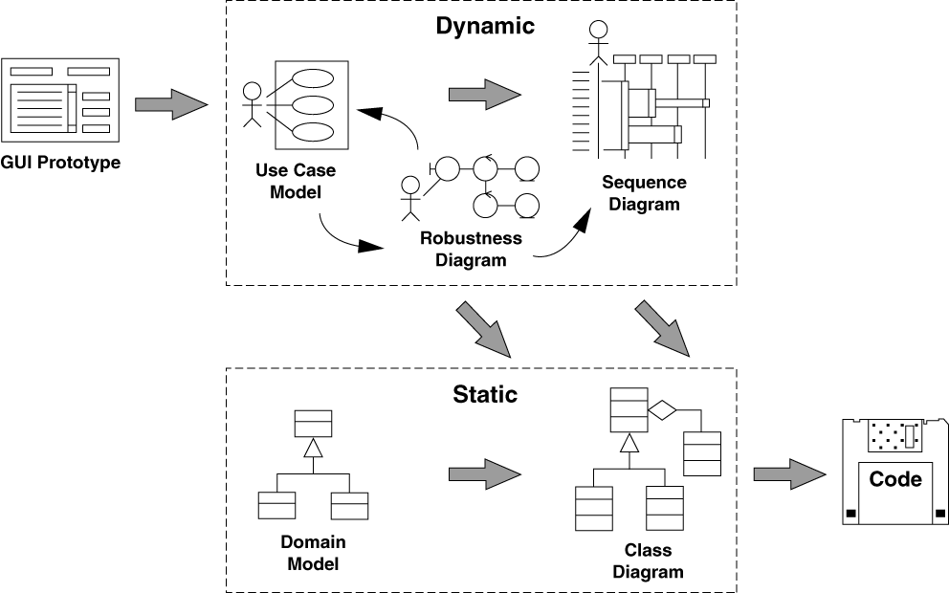
Let There Be A Unified Notation
Jacobson
Jacobson
Booch
Rumbaugh

Slide 18
UML Origin
A product of the “design wars” of the 1980’s
  Grady Booch, James Rumbaugh, and others had competing styles.
`94: Rumbaugh leaves GE to join Booch at Rational Software
  “Method wars over. We won.” Others feared achieving standardization the Microsoft way.
’95: Rational releases UML 0.8; Ivars Jacobson (use cases) joins Rational→“The Three Amigos”
’96: Object Management Group sets up task force on methods
’97: Rational proposed UML 1.0 to OMG. After arm twisting and merging, UML 1.1 emerges
’99: After several years of revisions and drafts, UML 1.3 is released
Now UML 1.5….
Notes:
10
Walk the audience through the timeline. Point out that the UML is the natural successor to the notations.
1. Late ‘80s and early ‘90 - there are many (50+) OO methodologies
2. Among the first generation methodologies, Booch and OMT stood out
3. Around 1993, second generation methodologies came out - Booch ‘93 and OMT-II. Methodologist borrowed good concepts from each others so many concepts were the same across the methodologies, but different notations.
4. Oct. 1994 - Dr. James Rumbaugh joined Rational to unify Booch & OMT.
5. At OOPSLA ‘95, Grady and Jim announced Unified Method 0.8.
6. Use Case technique developed by Dr. Ivar Jacobson was adapted by all
methodologies by then.
7. Rational acquires Objectory in fall of ‘95 - Dr. Ivar Jaconson joins Rational.
8. Jun of ‘96 - Rational submits UML 0.9 to OMG.
9. UML gains industry support from HP, Microsoft, Oracle + 16 others
10. UML is the defacto standard for OO and component technologies
11. The final submission goes in Sep. ‘97 - expect the announcement in Dec.

Slide 19
What is the UML…
UML stands for Unified Modeling Language
The UML combines the best of the best from
  Data Modeling concepts (Entity Relationship Diagrams)
  Business Modeling (work flow)
  Object Modeling
  Component Modeling
The UML is the standard language for visualizing, specifying, constructing, and documenting the artifacts of a software-intensive system
It can be used with all processes, throughout the development life cycle, and across different implementation technologies
Copyright © 1997 by Rational Software Corporation
Notes:
9
Core message -- second bullet
UML can be used to communicate system and software design throughout the life cycle

Slide 20
What UML Can Do for Us
Lets us make out mistakes on paper, before we write and debug the code
Lets us communicate our ideas better
Lets us tap into a wealth of existing designs (patterns) that lets us draw on others’ experience

Slide 21
UML goal
1) Provide users with a ready-to-use, expressive visual modeling language
2) Provide extensibility and specialization mechanisms to extend the core concepts.
3) Be independent of particular programming languages and development processes.
4) Provide a formal basis for understanding the modeling language.
5) Encourage the growth of the OO tools market.
6) Support higher-level development concepts such as collaborations, frameworks, patterns and components.
7) Integrate best practices.

Slide 22
Theory vs. practice
In theory, there is no difference between theory and practice, but in practice there is.
In practice, there’s never enough time for modeling.

Slide 23
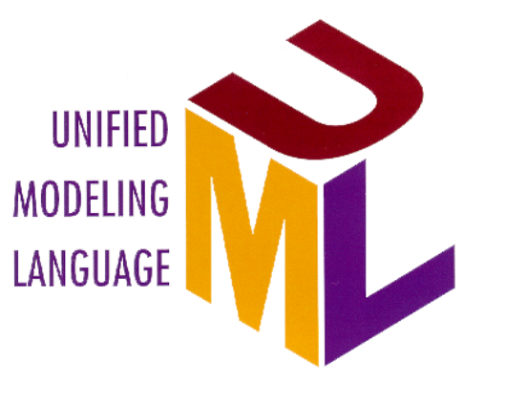
UML Supports
Relationships
Objects
Business Objects
large scale system
ORDBMS
Oracle
Classes
application partitioning
Components
Microsoft
Scenarios
CORBA
OMG
Use Cases
ActiveX/COM
Microsoft
Business Process
Notes:
11
Transition: So! Who should use UML? Everybody who is doing software development.
Core Message: UML supports object and component-based technology.
Key Point 1: UML is an expressive language that can be used to describe pretty much everything about software application.
- object technology: objet, class, relationships, scenario, Use Case
- component-based development: component, ActiveX/COM, CORBA
- large scale system, application partitioning

Slide 24
UML Concepts
The UML may be used to:
  Display the boundary of a system & its major functions using use cases and actors
  Illustrate use case realizations with interaction diagrams
  Represent a static structure of a system using class diagrams
  Model the behavior of objects with state transition diagrams
  Reveal the physical implementation architecture with component & deployment diagrams
  Extend your functionality with stereotypes
Copyright © 1997 by Rational Software Corporation
Notes:
12
The last set of slides briefly introduces most of the UML notations.
NOTE: Not all notations are covered due to time constraints

Slide 25
Classification of UML
user model view
  use case diagrams
Structural model view
  class diagrams
  object diagrams
Behavioral model view
  sequence diagrams
  collaboration diagrams
  state machine diagrams
  activity diagrams
Implementation model view
  component diagrams
Environment model view
  deployment diagrams

Slide 26
Last slide with modeling
State
Diagrams
State
Diagrams
Class
Diagrams
Use Case
Diagrams
Use Case
Diagrams
State
Diagrams
Use Case
Diagrams
Use Case
Diagrams
State
Diagrams
Use Case
Diagrams
Object
Diagrams
Sequence
Diagrams
Scenario
Diagrams
State
Diagrams
Scenario
Diagrams
State
Diagrams
Collaboration
Diagrams
Component
Diagrams
Models
Scenario
Diagrams
Component
Diagrams
Scenario
Diagrams
Component
Diagrams
State machine
Diagrams
Deployment
Diagrams
Activity
Diagrams

Slide 27
Exercise
(As we all know Class Model)
Try to make Class Model for a banking system ?
      !! Now !!

Slide 28
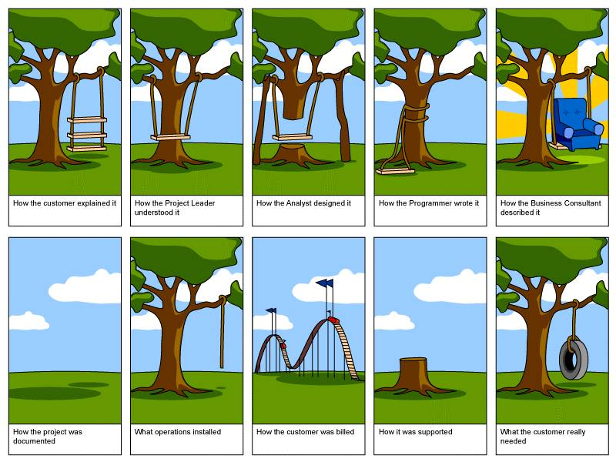
Building a system

Slide 29

Solution
The Class Model is the static architectural representation of your software .
Name of class Account
The Value is an attribute
Withdraw and Deposit are methods

Slide 30
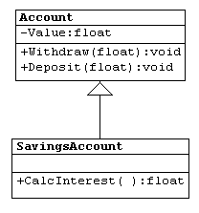
Solution...
Inheritance is represented by a triangle and SavingsAccount is a subclass of Account, inheriting all of the Attributes and Operations of the Account Class

Slide 31
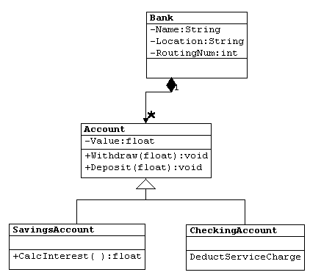
Solution...
Aggregation is represented by a diamond
Aggregation is a whole-part relationship.

Slide 32
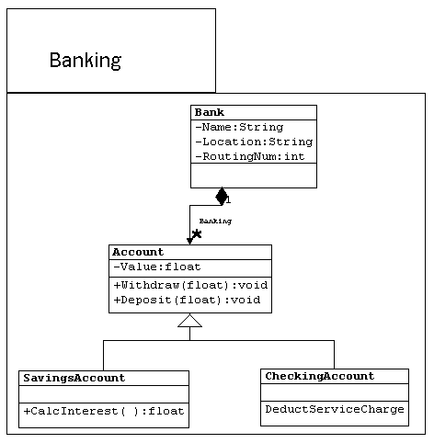
Solution...
A system which represents a group of related classes can often be placed together in what is called a package

Slide 33
Architectural Views and Diagrams
User model view
  relies on use case diagrams to describe the problem and its solution from the perspective of the customer or end user of a product
Structural model view
  describes static aspects of the system through class diagrams and object diagrams
Behavioral model view
  specifies dynamic aspects of the system through sequence diagrams, collaboration diagrams, state diagrams, and activity diagrams

Slide 34
Architectural Views and Diagrams…
Implementation model view
  concentrates on the specific realization of a solution, and depicts the organization of solution components in component diagrams
Environment model view
  shows the configuration of elements in the environment, and indicates the mapping of solution components to those elements through deployment diagrams

Slide 35
UML links
ArgoUML
    http://argouml.tigris.org/
Rational rose
    http://www-306.ibm.com/software/rational/
Link for UML tools
    http://www.objectsbydesign.com/tools/umltools_byCompany.html
UML specification
    http://www.uml.org/
For any detail
    http://www.google.com

Slide 36
Putting the UML to Work
The University wants to computerize their registration system
  The Registrar sets up the curriculum for a semester
    One course may have multiple course offerings
  Students select 4 primary courses and 2 alternate courses
  Once a student registers for a semester, the billing system is notified so the student may be billed for the semester
  Students may use the system to add/drop courses for a period of time after registration
  Professors use the system to receive their course offering
  Users of the registration system are assigned passwords which are used at logon validation
Notes:
13

Slide 37
Use cases
Definition
A use case defines a goal-oriented set of interactions between external actors and the system under consideration.
Do not go into the details of how the system interacts with the user
Use case diagrams represent the functionality of the system from user’s point of view

Slide 38
Actors
An actor is someone or some thing that must interact with the system under development
Registrar
Professor
Student
Billing System
Notes:
14

Slide 39
Use Cases
A use case is a pattern of behavior the system exhibits
  Each use case is a sequence of related transactions performed by an actor and the system in a dialogue
Actors are examined to determine their needs
  Registrar -- maintain the curriculum
  Professor -- request course roster
  Student -- maintain schedule
  Billing System -- receive billing information from registration
Maintain Curriculum
Request Course Roster
Maintain Schedule
Notes:
15

Slide 40
Documenting Use Cases
A flow of events document is created for each use cases
  Written from an actor point of view
Details what the system must provide to the actor when the use cases is executed
Typical contents
  How the use case starts and ends
  Normal flow of events
  Alternate flow of events
  Exceptional flow of events
Notes:
16

Slide 41
Maintain Curriculum Flow of Events
This use case begins when the Registrar logs onto the Registration System and enters his/her password. The system verifies that the password is valid and prompts the Registrar to select the current semester or a future semester. The Registrar enters the desired semester. The system prompts the professor to select the desired activity: ADD, DELETE, REVIEW, or QUIT.
If the activity selected is ADD, : Add a Course subflow is performed.
If the activity selected is DELETE,: Delete a Course subflow is performed.
If the activity selected is REVIEW, : Review Curriculum subflow is performed.
If the activity selected is QUIT, the use case ends.
...
Notes:
17

Slide 42
Use Case Diagram
Use case diagrams are created to visualize the relationships between actors and use cases
Request Course Roster
Student
Professor
Maintain Schedule
Billing System
Maintain Curriculum
Registrar
Notes:
18

Slide 43
Uses and Extends Use Case Relationships
As the use cases are documented, other use case relationships may be discovered
  A uses relationship shows behavior that is common to one or more use cases
  An extends relationship shows optional behavior
<<uses>>
Register for courses
<<uses>>
Logon validation
Maintain curriculum
Notes:
19

Slide 44
Finding Primary Actors, Goals and Use Cases
Use cases are defined to satisfy the user goals of the actors.
The basic procedures are:
Choose the system boundary. Is it just a software application, a mix of hardware and software, that plus a person using it or an entire organization?
Identify the actors – those that have user goals fulfilled through using services of the system.
For each identify their user goals. Raise them to the highest user goal level.
Define use cases that satisfy user goals and name them according to their goal.

Slide 45
Use Case Example (Help me in writing Use Cases ?)
Problem description
Each elevator has a set of floor buttons, one for each floor. Any person inside the elevator can press the floor buttons. The buttons illuminate when pressed and cause the elevator to visit the corresponding floor. The illumination is cancelled when the corresponding floor is visited by the elevator.
An emergency button can also be pressed, in which case a technician will be called automatically to fix the elevator.
The technician can use a key to activate or deactivate the elevator, which deactivates all floor buttons.
The basement, because of security reasons, is accessible only by the security officer by using a key that unlocks the basement floor button.
All the elevators are controlled by a central/external unit at the reception desk.

Slide 46
Use Case Example
Actors and goals:
Floor visitor - visit a floor, call a technician;
Technician – activate the elevator, deactivate the elevator, repair the elevator;
Security officer - visit the basement, visit a floor, call technician;
Central unit – control the elevator.

Slide 47
Class Diagrams
A class diagram shows the existence of classes and their relationships in the logical view of a system
UML modeling elements in class diagrams
  Classes and their structure and behavior
  Association, aggregation, dependency, and inheritance relationships
  Multiplicity and navigation indicators
  Role names
Notes:
23

Slide 48
Classes
A class is a collection of objects with common structure, common behavior, common relationships and common semantics
Classes are found by examining the objects in sequence and collaboration diagram
A class is drawn as a rectangle with three compartments
Classes should be named using the vocabulary of the domain
  Naming standards should be created
  e.g., all classes are singular nouns starting with a capital letter
Notes:
24

Slide 49
Classes
ScheduleAlgorithm
RegistrationForm
RegistrationManager
Course
Student
Professor
CourseOffering
Notes:
25

Slide 50
Operations
The behavior of a class is represented by its operations
Operations may be found by examining interaction diagrams
registration
registration
form
manager
RegistrationManager
3: add course(joe, math 01)
addCourse(Student,Course)
Notes:
26

Slide 51
Attributes
The structure of a class is represented by its attributes
Attributes may be found by examining class definitions, the problem requirements, and by applying domain knowledge
Each course offering
has a number, location
and time
CourseOffering
number
location
time
Notes:
27

Slide 52
Relationships
Relationships provide a pathway for communication between objects
Sequence and/or collaboration diagrams are examined to determine what links between objects need to exist to accomplish the behavior -- if two objects need to “talk” there must be a link between them
Three types of relationships are:
  Association
  Aggregation
  Dependency
Notes:
29

Slide 53
Relationships
An association is a bi-directional connection between classes
  An association is shown as a line connecting the related classes
An aggregation is a stronger form of relationship where the relationship is between a whole and its parts
  An aggregation is shown as a line connecting the related classes with a diamond next to the class representing the whole
A dependency relationship is a weaker form of relationship showing a relationship between a client and a supplier where the client does not have semantic knowledge of the supplier
A dependency is shown as a dashed line pointing from the client to the supplier
Notes:
30

Slide 54
Finding Relationships
Relationships are discovered by examining interaction diagrams
  If two objects must “talk” there must be a pathway for communication
RegistrationManager
Registration
Math 101:
Manager
Course
3: add student(joe)
Course
Notes:
31

Slide 55
Relationships
RegistrationForm
ScheduleAlgorithm
RegistrationManager
addStudent(Course, StudentInfo)
Course
name
numberCredits
Student
open()
name
addStudent(StudentInfo)
major
Professor
name
CourseOffering
tenureStatus
location
open()
addStudent(StudentInfo)
Notes:
32

Slide 56
Multiplicity and Navigation
Multiplicity defines how many objects participate in a relationships
  Multiplicity is the number of instances of one class related to ONE instance of the other class
  For each association and aggregation, there are two multiplicity decisions to make: one for each end of the relationship
Although associations and aggregations are bi-directional by default, it is often desirable to restrict navigation to one direction
If navigation is restricted, an arrowhead is added to indicate the direction of the navigation
Notes:
33

Slide 57
Multiplicity and Navigation
RegistrationForm
ScheduleAlgorithm
0..*
1
RegistrationManager
addStudent(Course, StudentInfo)
1
0..*
Course
name
numberCredits
Student
open()
major
addStudent(StudentInfo)
1
3..10
Professor
1..*
4
CourseOffering
tenureStatus
1
location
0..4
open()
addStudent(StudentInfo)
Notes:
34

Slide 58
Inheritance
Inheritance is a relationships between a superclass and its subclasses
There are two ways to find inheritance:
  Generalization
  Specialization
Common attributes, operations, and/or relationships are shown at the highest applicable level in the hierarchy
Notes:
35

Slide 59
Inheritance
RegistrationForm
ScheduleAlgorithm
RegistrationManager
addStudent(Course, StudentInfo)
Course
RegistrationUser
name
name
numberCredits
Student
open()
major
addStudent(StudentInfo)
Professor
CourseOffering
tenureStatus
location
open()
addStudent(StudentInfo)
Copyright © 1997 by Rational Software Corporation
Notes:
36

Slide 60
Associations
Associations denote relationships between classes.
The multiplicity of an association end denotes how many objects the source object can legitimately reference.
Has-capital
Country
1
1
City
name:String
name:String
Has
Polygon
1
*
Point
x:Integer
y:Integer
draw()

Slide 61
Aggregation
An aggregation is a special case of association denoting a “consists of” hierarchy.
The aggregate is the parent class, the components are the children class.
Exhaust System
1
0..2
Muffler
Tailpipe

Slide 62
Composition
A solid diamond denote composition, a strong form of aggregation where components cannot exist without the aggregate.
TicketMachine
3
ZoneButton

Slide 63
Generalization
Button
CancelButton
ZoneButton
Generalization relationships denote inheritance between classes.
The children classes inherit the attributes and operations of the parent class.
Generalization simplifies the model by eliminating redundancy.

Slide 64
Behavioral /Dynamic Model View
  State machine diagrams
  Activity diagrams
  Sequence diagrams
  Collaboration diagrams
  Object diagram

Slide 65
State Machine Diagram
UML state machine diagrams depict the various states that an object
And the transitions between those states
State diagrams show the change of an object over time
Very useful for concurrent and real-time systems

Slide 66
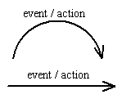



State Machine Diagram Symbols and Notations
Final state
Initial state

Slide 67
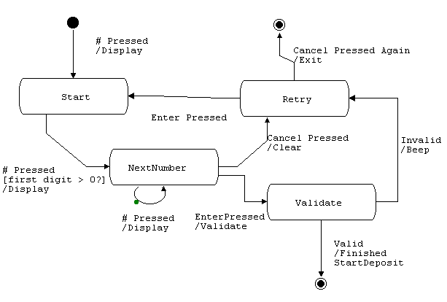
State machine diagram (Key entry user password)

Slide 68
Activity Diagram:
Activity diagrams are typically used for business process modeling
For modeling the detailed logic of a business rule
Model the internal logic of a complex operation
An activity diagram is a special case of a state chart diagram in which states are activities (“functions”)
Activity diagrams are the object-oriented equivalent of flow charts and data flow diagrams (DFDs)

Slide 69

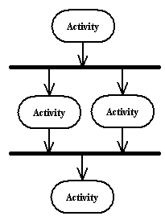
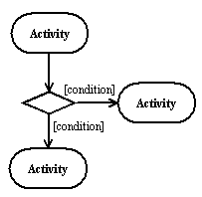
Activity Diagram Symbols and Notations
Final state
Initial state
Branching
Parallel Behaviour

Slide 70
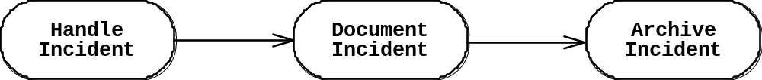
Activity Diagrams Example
An activity diagram shows flow control within a system

Slide 71
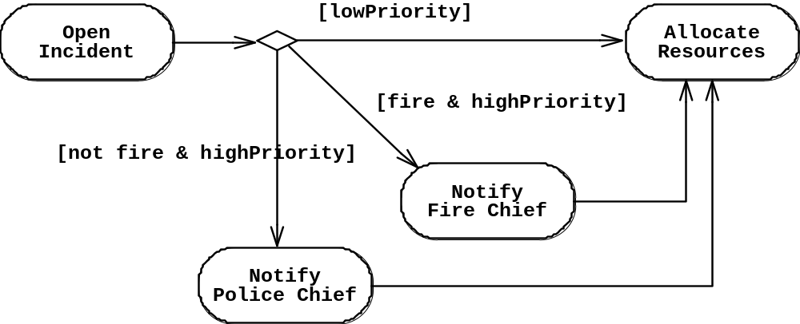
Activity Diagram: Modeling Decisions

Slide 72
Activity Diagrams: Modeling Concurrency
Synchronization of multiple activities
Splitting the flow of control into multiple threads
Splitting
Synchronization
Allocate
Resources
Open
Coordinate
Archive
Incident
Resources
Incident
Document
Incident

Slide 73
Activity Diagrams: Swimlanes
Actions may be grouped into swimlanes to denote the object or subsystem that implements the actions.
Dispatcher
Allocate
Resources
Open
Coordinate
Archive
Incident
Resources
Incident
FieldOfficer
Document
Incident

Slide 74
When State and Activity Diagram
Activity diagrams are used to show workflow in parallel and conditionally. They are useful when working out the order and concurrency of a sequential algorithm, when analyzing the steps in a business process and when working with threads
State diagrams show the change of an object over time and are useful when an object exhibits interesting or unusual behaviour
Use these diagrams only when they serve a purpose. Don't feel that you have to draw a state diagram for every object in your system and an activity diagram for every process

Slide 75
Interaction diagram
Interaction diagrams describe how use cases are realized as interactions among societies of objects
Use case shows an interaction between a user and a system
Interaction diagram captures the behaviour of a single case by showing the collaboration of the objects in the system to accomplish the task
Two types of interaction diagrams
  Sequence diagrams
  Collaboration diagrams
Notes:
20

Slide 76
Sequence diagrams
The sequence diagram describes the flow of messages being passed from object to object

Slide 77

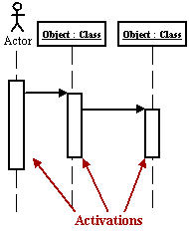
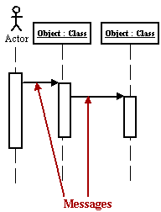
Sequence diagrams Symbols and Notations

Slide 78
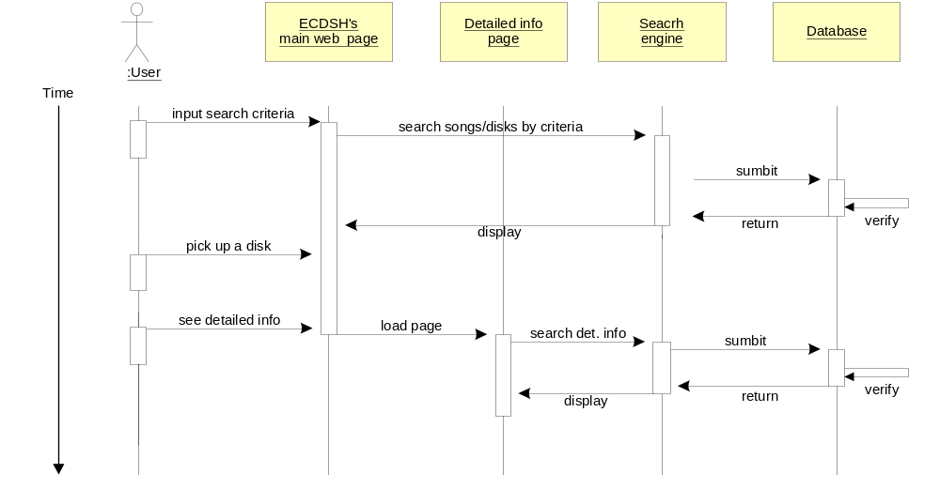
Sequence Diagrams Example
Activation
Message

Slide 79
Collaboration diagrams
  Collaboration diagrams
  Collaboration diagrams model the interactions between objects. This type of diagram is a cross between an object diagram and a sequence diagram. Unlike the Sequence diagram, which models the interaction in a column and row type format, the Collaboration diagram uses the free-form arrangement of objects as found in an Object diagram. This makes it easier to see all interations involving a particular object

Slide 80


Collaboration Diagram Notation & Example
An Administrator using a Web Application to manage a user account. Notice how you can follow the process from object to object, according to the outline below:
1. Find User
1.1 LookUpUser
2. Update User
2.1 ValidateUser
2.2 UpdateUser
Notes:
22

Slide 81
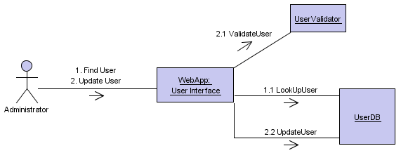
Collaboration Diagram Example
Administrator‘S action

Slide 82
Interactation diagram details
Using interaction diagrams, we can clarify the sequence of operation calls among objects used to complete a single use case
Collaborations have the added advantage of interfaces and freedom of layout, but can be difficult to follow, understand and create.
Interaction diagrams are used to diagram a single use case. When you want to examine the behaviour of a single instance over time use a state diagram, and if you want to look at the behaviour of the system over time use an activity diagram.

Slide 83
Component diagram
Component diagrams illustrate the organizations and dependencies among software components
A component may be
  A source code component
  A run time components or
  An executable component
Notes:
39

Slide 84
Component diagram
CreditCard
Charger
CreditCardAgent
<<database>>
OrderDB
Status
Purchase
Order
Manager
OrderProcess
CarSale
GoodsSale
Coordinate
Manager
Interface
Manager
CarSeller
Client

Slide 85
Deployment diagram
The Deployment diagram models the hardware used in implementing a system and the association between those hardware components
The deployment diagram visualizes the distribution of components across the enterprise
Notes:
41

Slide 86
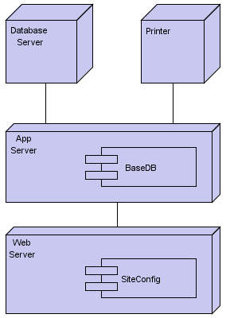
Deployment Diagram Example

Slide 87
Use Case Based Testing (UCBT)
Writing test case from Use case
Test cases that are derived from use cases take advantage of the existing specification to ensure good functional test coverage of the system.

Slide 88
What we write in Use Case
Name
Brief Description
SRS Requirements Supported
Pre & Post Conditions
Event Flow

Slide 89
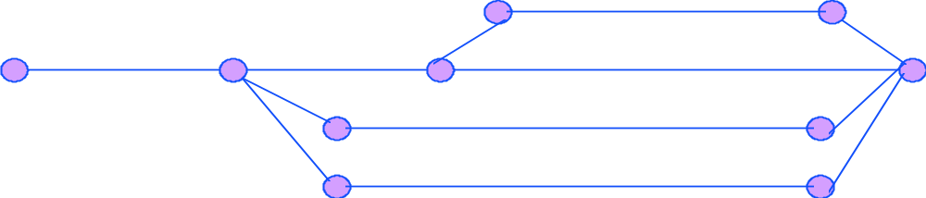
Start and End of the Use Case
The Pre-Condition specifies the required state of the system prior the start of the Use Case.
This can be used for a similar purpose in the Test Case.
The Post-Condition is the state of the system after the actor interaction.
This may be used for test pass/fail criteria
Start
End

Slide 90
UCBT : Example
Monitor and control the normal entry and exit of building occupants through the use of personal security cards.
This includes entry and exit of the building proper, and entry and exit from particular security zones within the building.
The system controls the locks on the doors, and will not unlock a door unless the appropriate security card is swiped through the card reader by the door

Slide 91
Use Cases for this example
Enter Building :
  Employee enters the building using card reader passage
Exit Building :
  Employee exits the building using card reader passage
Enter Security Zone:
  Cleared Employee enters the vault using card reader passage
Exit Security Zone:
  Cleared Employee exits the vault using card reader passage
System Maintenance:
  Authorized user enters/edits employee card data

Slide 92
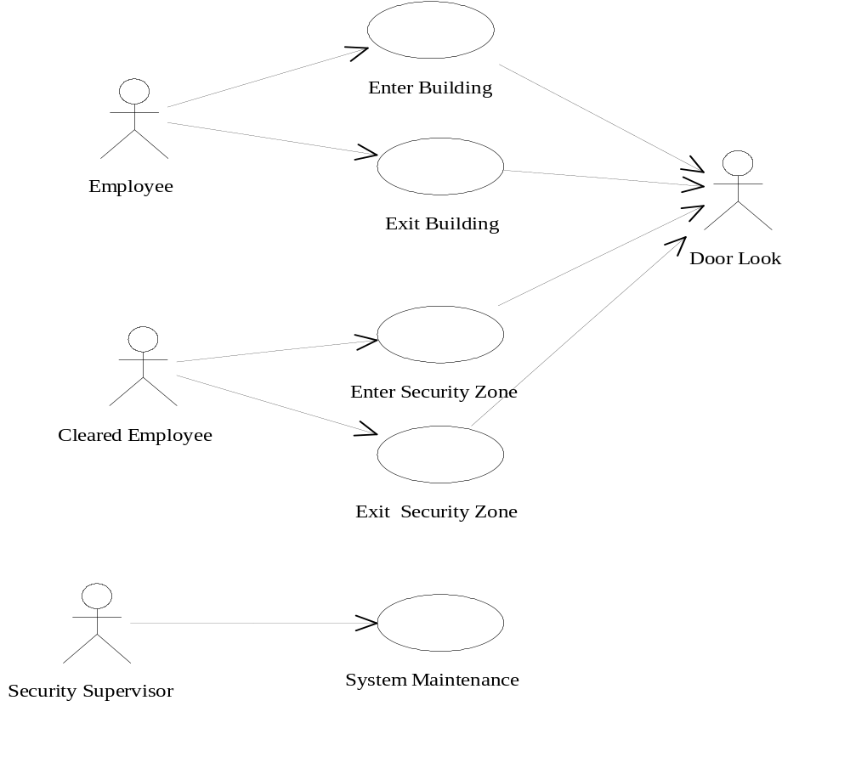
Use Case diagram

Slide 93
Test Cases
Test Condition 1: True – valid employee card is used
Swipe card
Verify door is unlocked
Enter building
Verify door is locked
Test Condition 2: Card can’t be read
Swipe a card that is not valid
Verify event is logged
Test Condition 3: Invalid employee ID
Swipe card with invalid employee ID
Verify door is not unlocked
Verify event is logged

Slide 94
Test Cases…
Test Condition 4: System unable to unlock door
Swipe card
“Injected” failure of unlocking mechanism
Verify event is logged
Test Condition 5: Door is not opened
Swipe card
Verify door is unlocked
Don’t open the door and wait until timeout is exceeded
Verify door is locked
Test Condition 6: Door is not shut after entry
Swipe card
Enter building
Hold door open until timeout is exceeded
Verify alarm is sounded
Verify event is logged

Slide 95
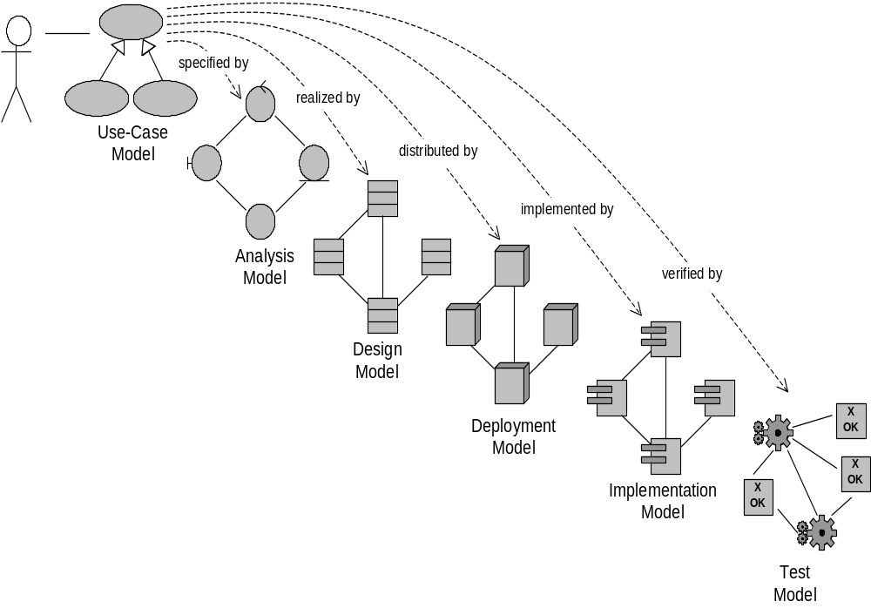
Use Case Driven Model

Slide 96
Thank You

